Slide 1




PRICE SALIENCE &
RENTAL BEHAVIOR
IN BOSTON
TEAM 10
ALIMA ABDIROVA
JESSICA TONG
OUMOU BARRY
DHRUV SHAH
SONYA DREYER

Slide 2


AGENDA
01
02
03
Research Question
Methods
Data Analysis
04
05
Limitations
Conclusion

Slide 3

RESEARCH
QUESTION
Experiment objective: Investigate the impact of price salience on renting behavior and perceived fairness in Boston's housing market.
Hypothesis: Having less salience fees will increase potential apartment seeker’s likelihood to sign the apartment.
Prior research suggests that heightened price salience decreases willingness to pay and promotes cautious decision-making.

Slide 4



METHODOLOGY
TREATMENT
CONTROL
Participants were shown the price of apartments, including additional fees such as broker fees and monthly expenses.
Participants in the control group were shown an all-inclusive price for the apartments, without any additional fees specified.
Rent: $1000/month per room
+ monthly broker’s fee: 8% of rent + monthly estimated utilities: 3% of rent
Rent: $1123/month per room all inclusive
(broker’s fee, utilities)

Slide 5

METHODOLOGY
RANDOMIZATION
OUTCOMES
Simple random sampling
Qualtrics' built-in feature to randomly assign respondents in equal proportions.
Likelihood of signing a lease
Perception of pricing fairness
Suggested fair price

Slide 6



DATA ANALYSIS
01
EDA
02
ATE, CATE, Power Analysis
03
Regressions

Slide 7

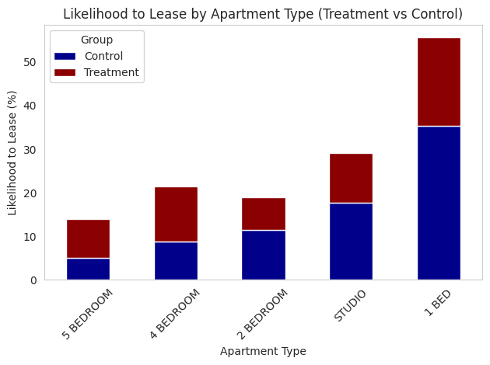

Slide 8
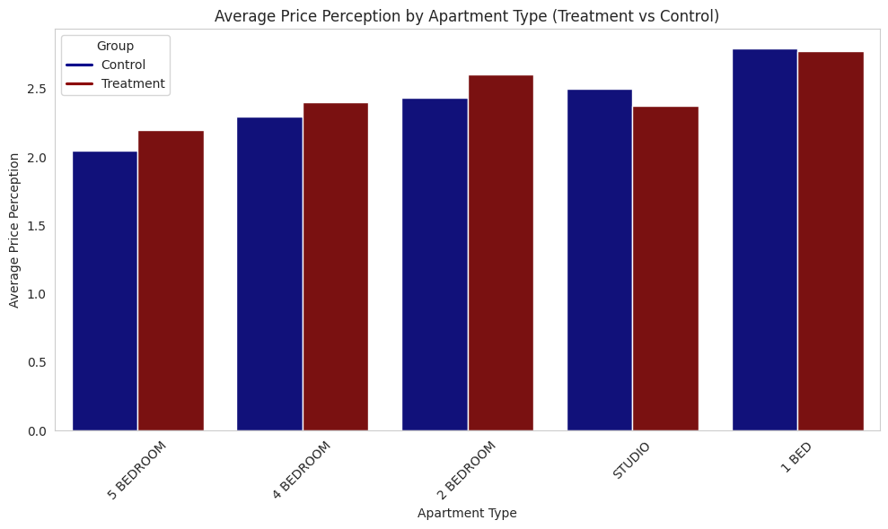

Slide 9


ATE
CATE
Likelihood of signing the lease
Is Men; Likelihood of signing the lease
-0.12
-0.31
1
5
1
5
Extremely Unlikely
Extremely likely
Extremely Unlikely
Extremely likely
CATE
Is Women; Likelihood of signing the lease
Treatment
0.08
Control
1
5
Extremely Unlikely
Extremely likely

Slide 10
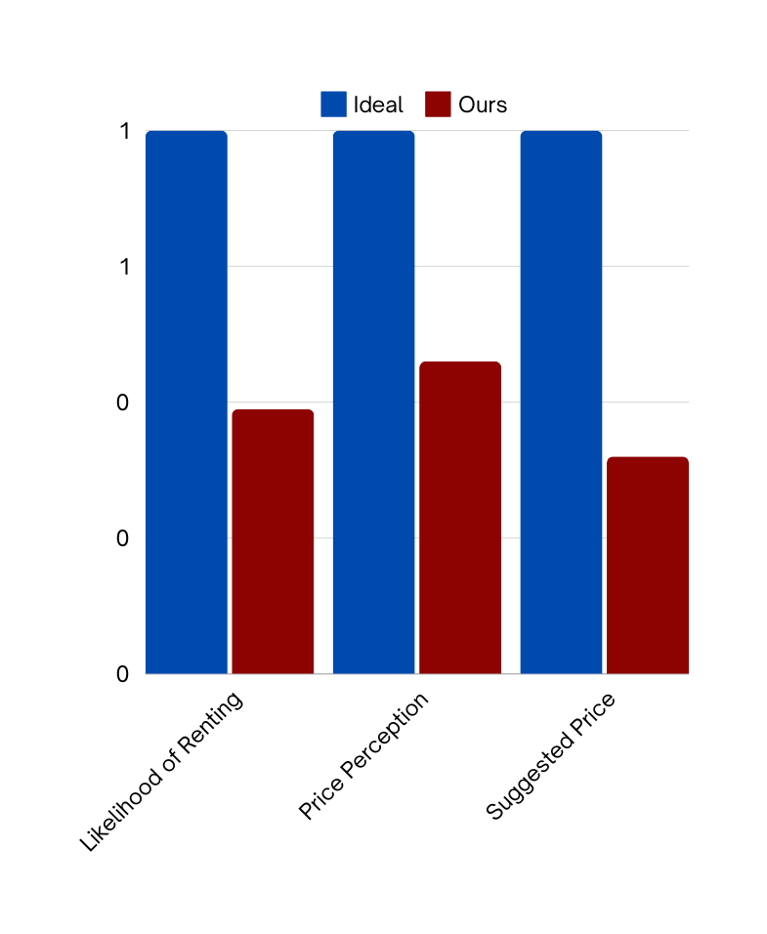
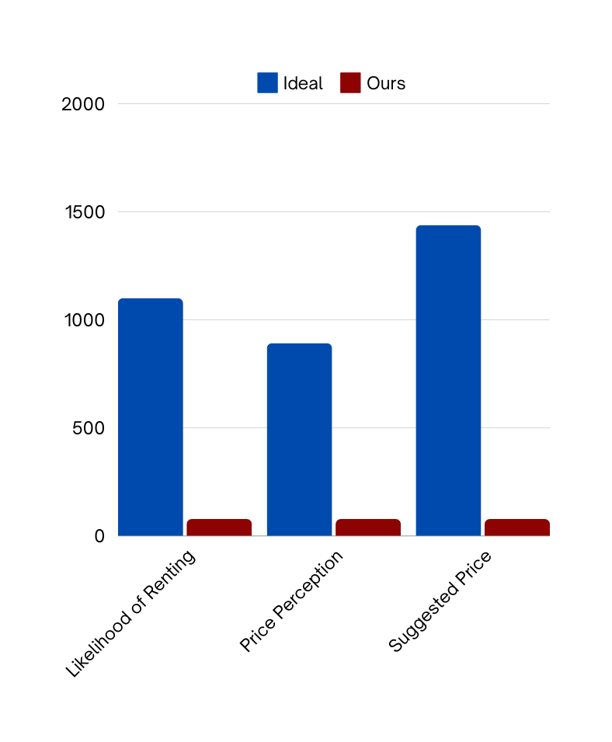
Stats Power
Sample Size

Slide 11
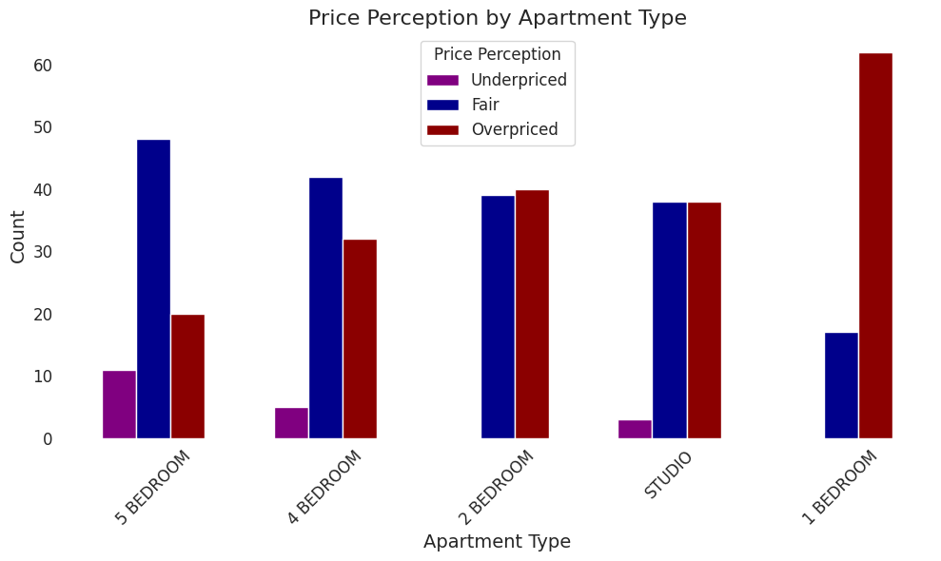

Slide 12
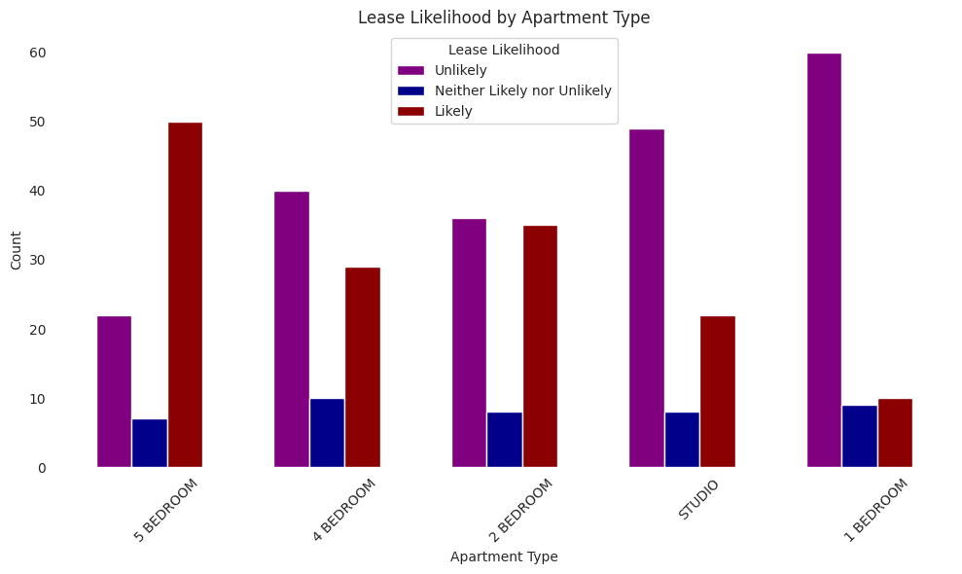

Slide 13
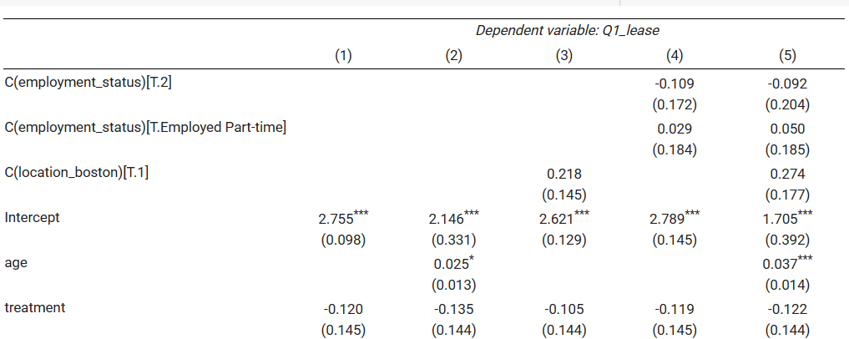
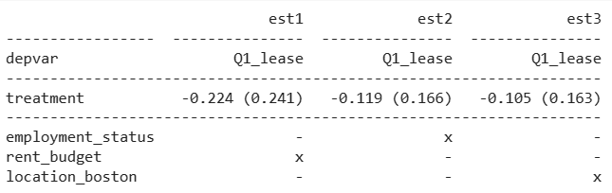
LEASE
LIKELIHOOD

Slide 14
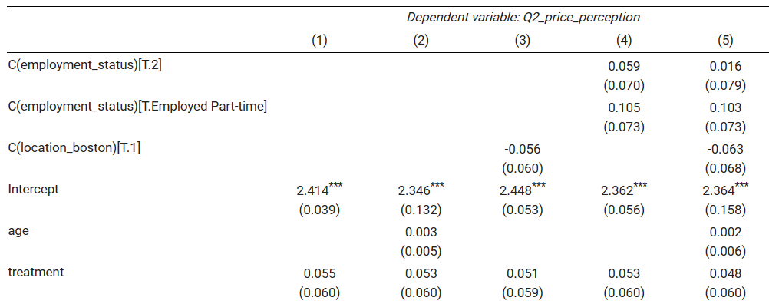
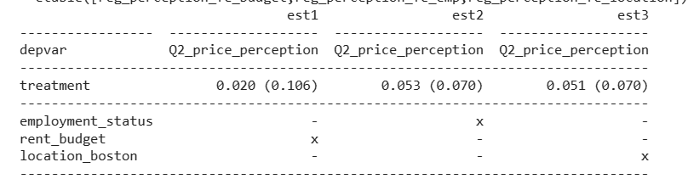
PRICE
PERCEPTION

Slide 15
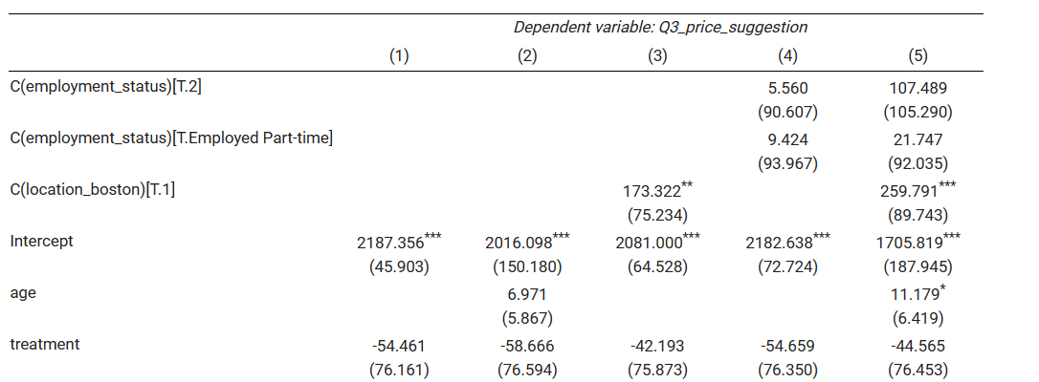
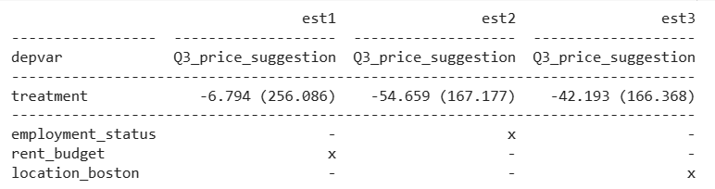
PRICE
SUGGESTION

Slide 16
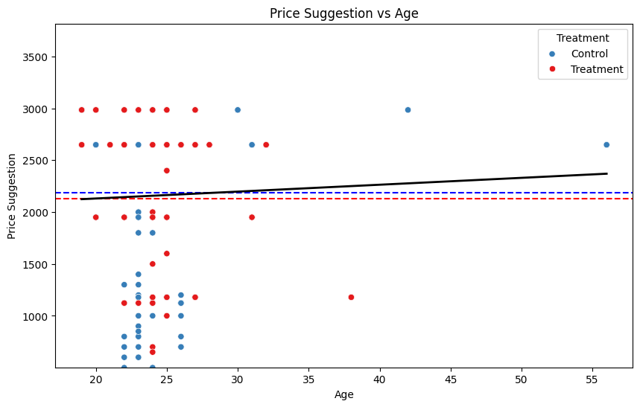

Slide 17
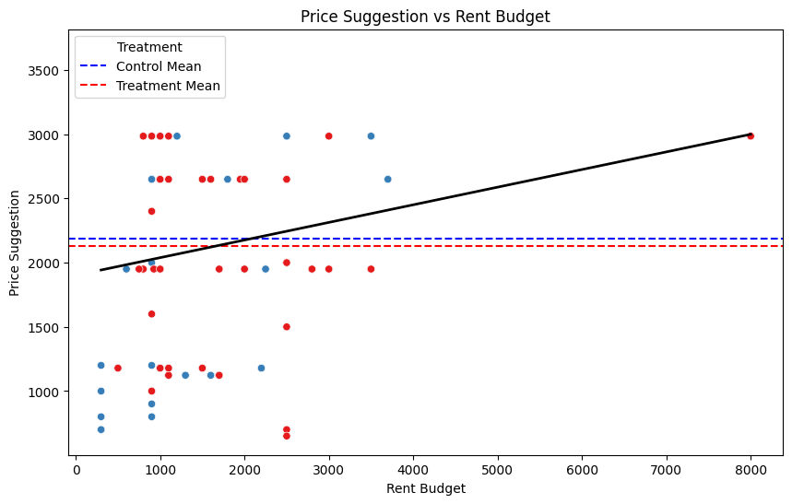

Slide 18
LIMITATIONS
PROBLEMS
GENERALIZABILITY
BIASES
Hypothetical Bias
Social Desirability Bias
Information Bias
Preference Uncertainty
Spam entries disrupted intended proportions, causing sample imbalance.
Smaller sample size reduced statistical power
Experiment on price salience is generalizable to a wider population.
Attitudes towards prices may vary based on regional housing market dynamics

Slide 19

CONCLUSION
From our experiment we couldn’t find that having less price salience would increase the willingness of people to rent the proeprty
The results are inconclusive due to the small sample size, leading to the reduction in statistical power as well as unequal proportion size
What we could have done differently?
Need a larger sample size for the statistical power
Would not only focus on Boston (generalizability)
Add treatment arm(s) (different levels of salience)

Slide 20
THANK YOU!

